Slide 1
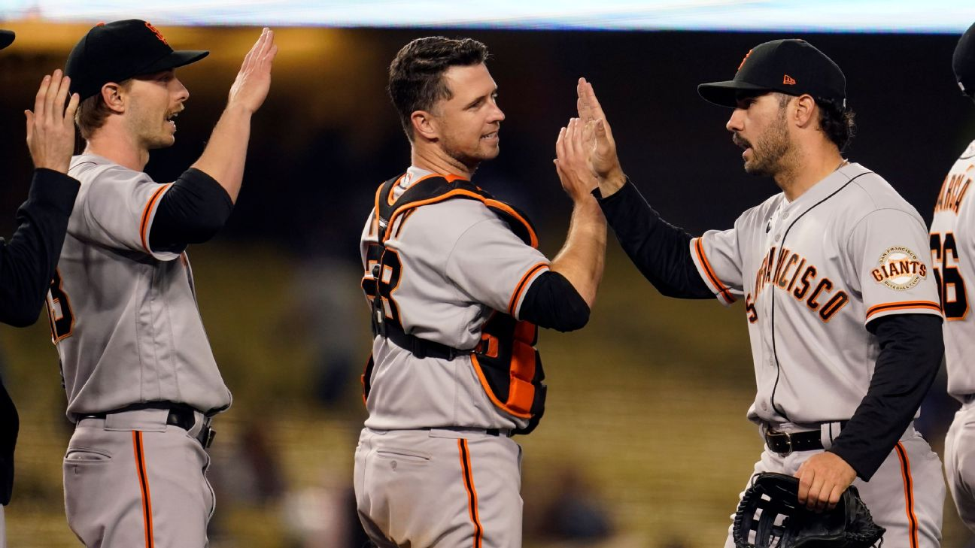
MLB Player Valuation Salary Predictions
Team 40
Aayush Chordia, Haoyang Dong, Deepika Karan, Ethan Shear, Anh Tuong

Slide 2
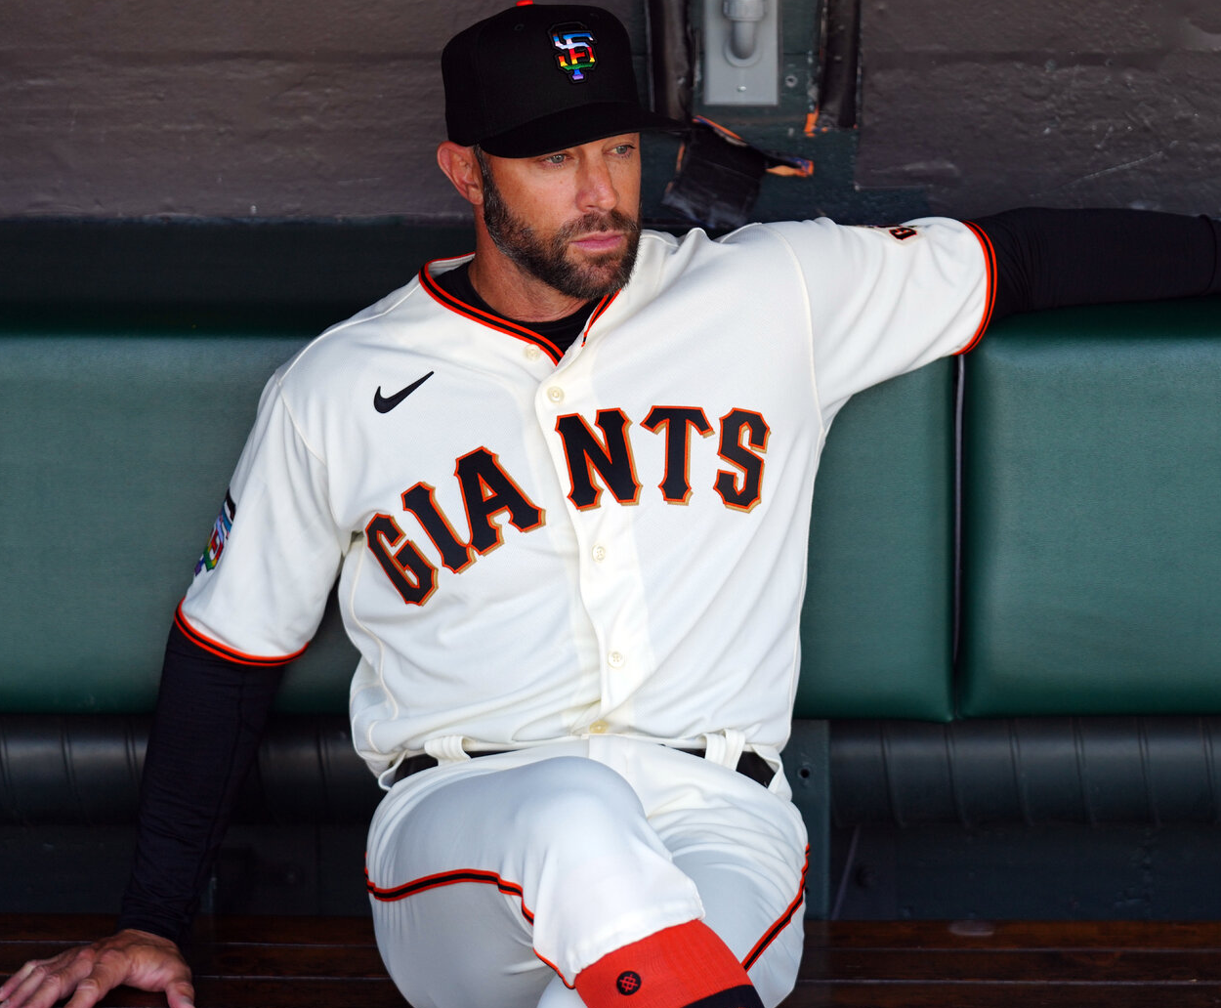
MLB front offices' primary responsibility is to build as talented a roster as possible within strict budgetary constraints.
The current state of baseball:
Player contracts reach record highs for average annual value (AAV) each offseason
Small market teams (~40M-70M) payroll must find ways to compete with large market teams (~200M+)
Data science and analytics have become the primary tool used to drive strategic decision making in scouting, player development, roster construction, and more
The current state of the Giants:
Won their division in 2021, missed playoffs in 2022
Aging stars and a new front office
Top 10 baseball market size and payroll
Business Use Case Data Understanding EDA Modeling & Evaluation Deployment Potential Drawbacks

Slide 3
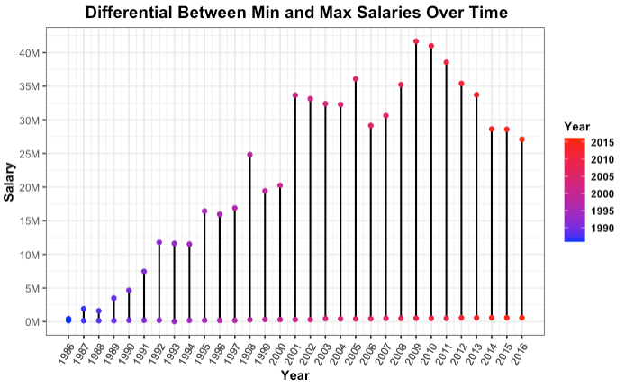
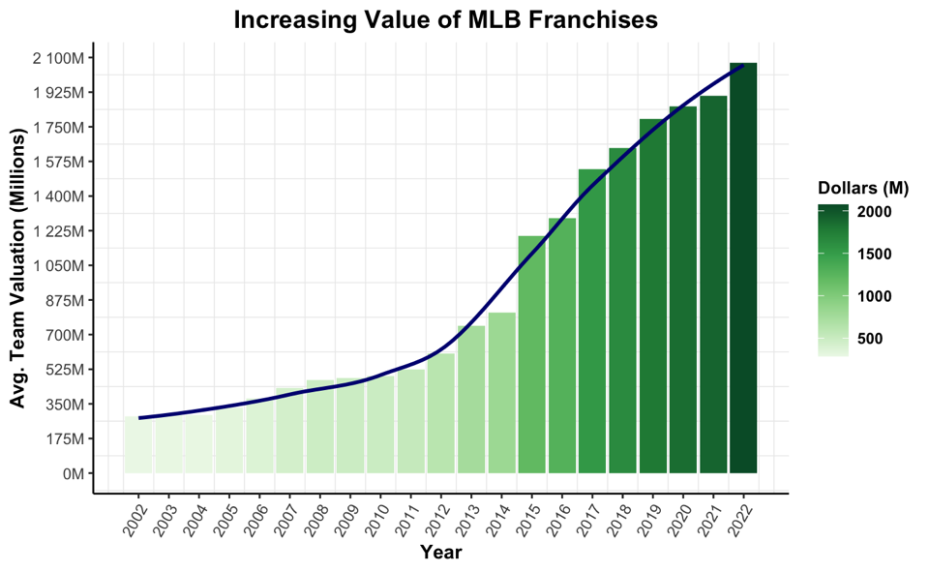
Both the variables and salaries used in player valuations have changed throughout
time, so our data required several standardization procedures.
We acquired data used in our modeling from three primary sources:
Lahman database (Batting, Fielding, Salaries, Awards)
Federal Reserve Bank of Minneapolis (Inflation Adjustment)
Statista & Forbes (MLB Team Valuations)
The exponential growth in team valuations and salaries required the standardization of salaries and the implementation of a proxy variable to account for different baseball market budget constraints
Business Use Case Data Understanding EDA Modeling & Evaluation Deployment Potential Drawbacks

Slide 4
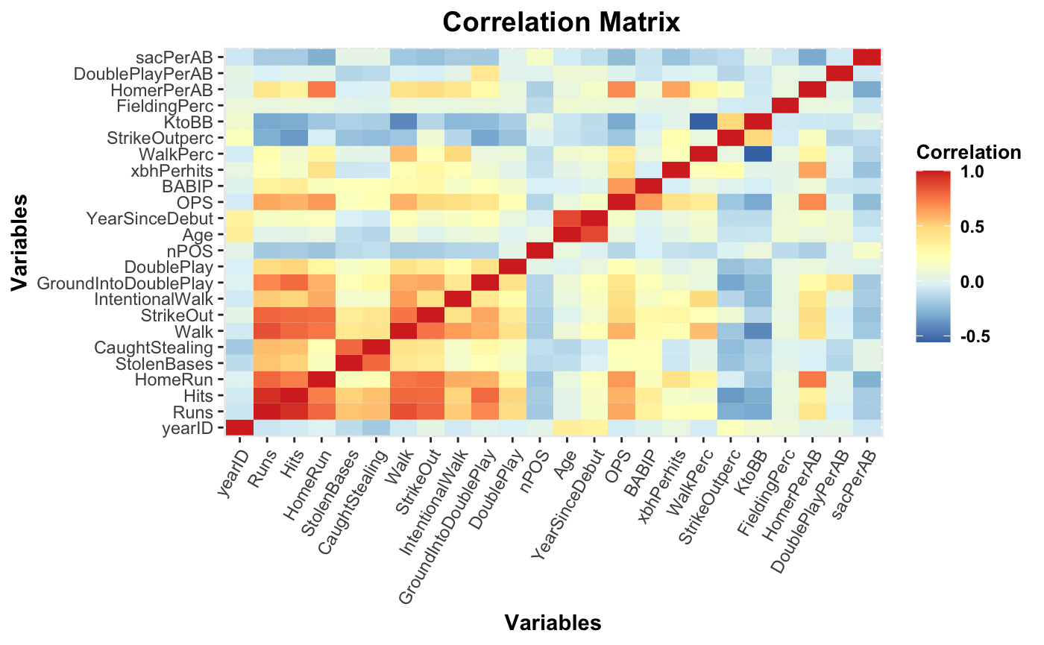
We chose to apply our model to hitters only to avoid confounding variables, and chose our variables based on several correlation matrices.
Baseball is a game driven by stats, and there are several widely used metrics to value players
Key Model Attributes:
Homeruns
Hits
K / BB Ratio
OPS
Years Since Debut
Business Use Case Data Understanding EDA Modeling & Evaluation Deployment Potential Drawbacks

Slide 5
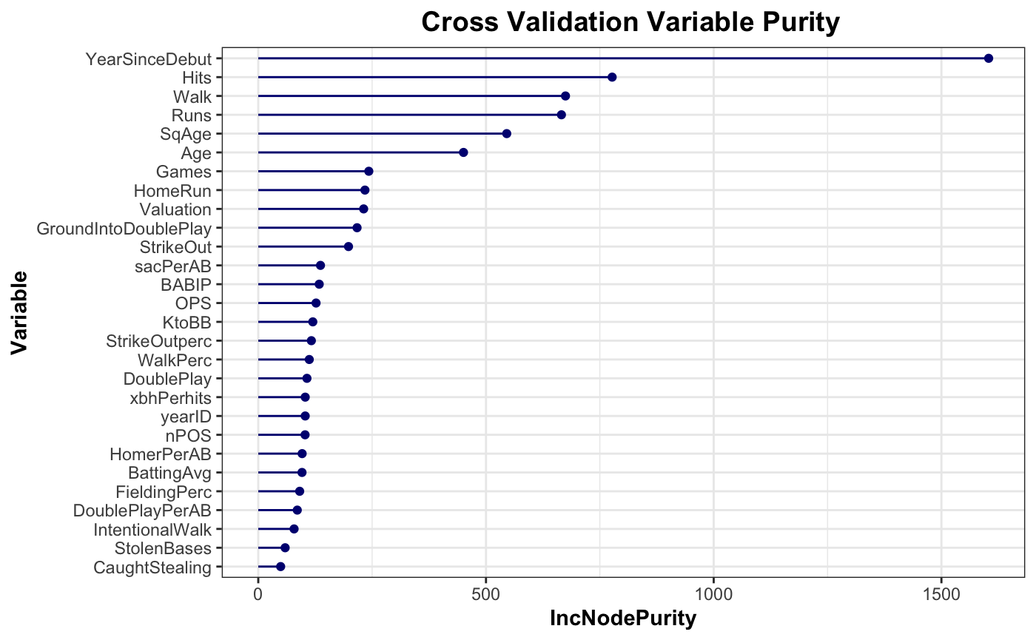
The most accurate predictions were found using ensemble learning through a
Random Forest model.
We used several different modeling techniques but chose Random Forest due to:
Non-linear relationships between features and observations
Uneven scale between standard and advanced metrics
Model performance tested using K-Fold Cross-Validation
Business Use Case Data Understanding EDA Modeling & Evaluation Deployment Potential Drawbacks

Slide 6
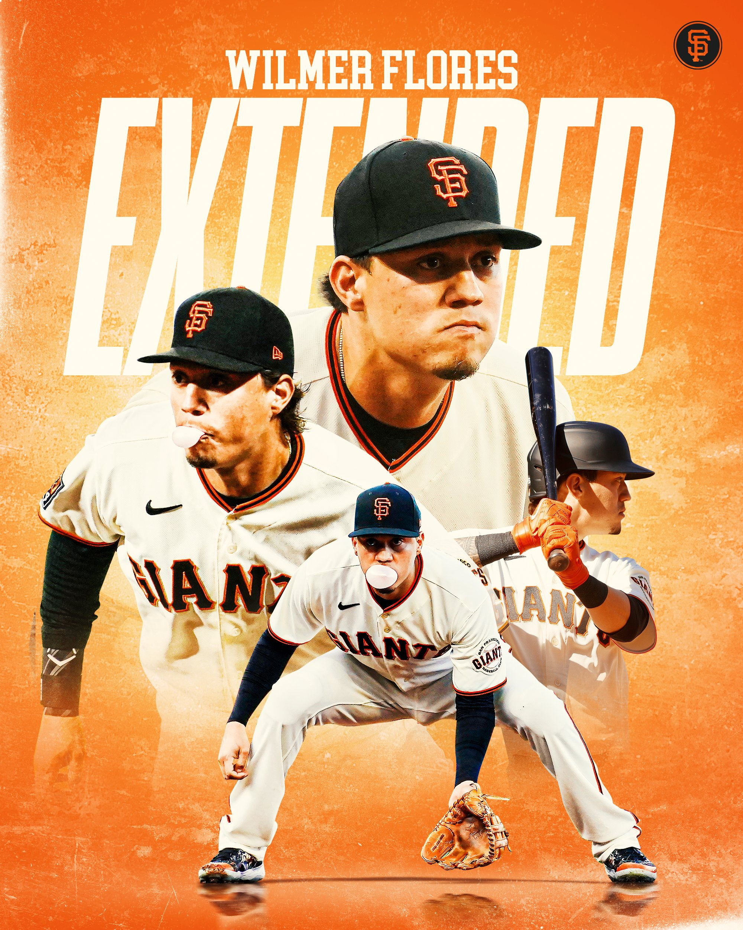
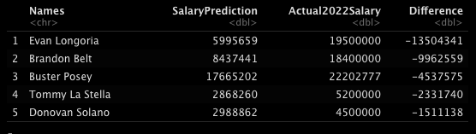
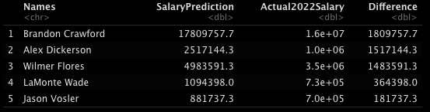
The San Francisco Giants have several aging stars on their roster and should consider trading them for prospects to improve their championship outlook.
We applied our model to hitters on the 2021 San Francisco Giants:
The aging stars were overvalued, while utilityman Wilmer Flores was among those undervalued by the model. The predicted salary outperformed his actual salary by 1.4 million; consequently, he received an extension the following offseason
Longoria, Posey, and Belt hit more extra base hits and played in more games than some teammates, yet the model accounted for their age and decline over the last decade and deemed them the three most overvalued and by a combined $30 million
Overvalued →
Undervalued →
Business Use Case Data Understanding EDA Modeling & Evaluation Deployment Potential Drawbacks

Slide 7
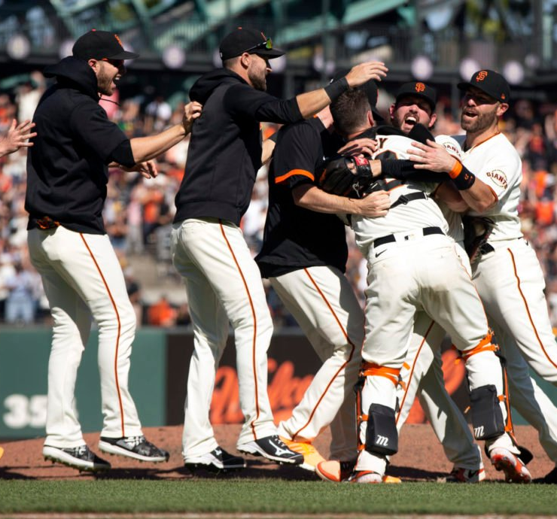
Drawbacks in our model's effectiveness come from using past performance as a predictor of future value and the importance of marketability in contract negotiations.
The variables used to build are model are largely performance based and could have limited effectiveness given how quickly performance may drop-off
Some possible issues that could be considered in a later model include:
Team dynamics, relationships, chemistry
Player brand value, marketability, endorsements
Bio-mechanic data and ball-flight data
Business Use Case Data Understanding EDA Modeling & Evaluation Deployment Potential Drawbacks

Slide 8
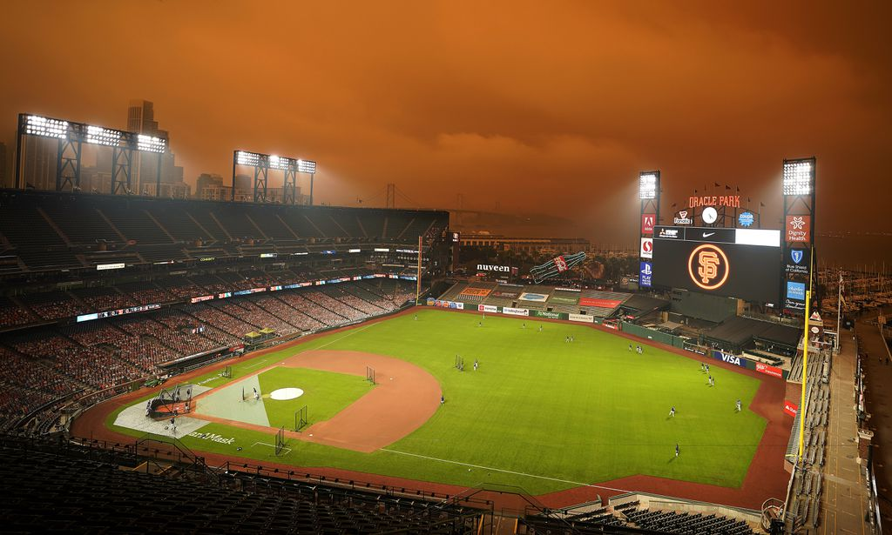
Thank you

